Slide 1
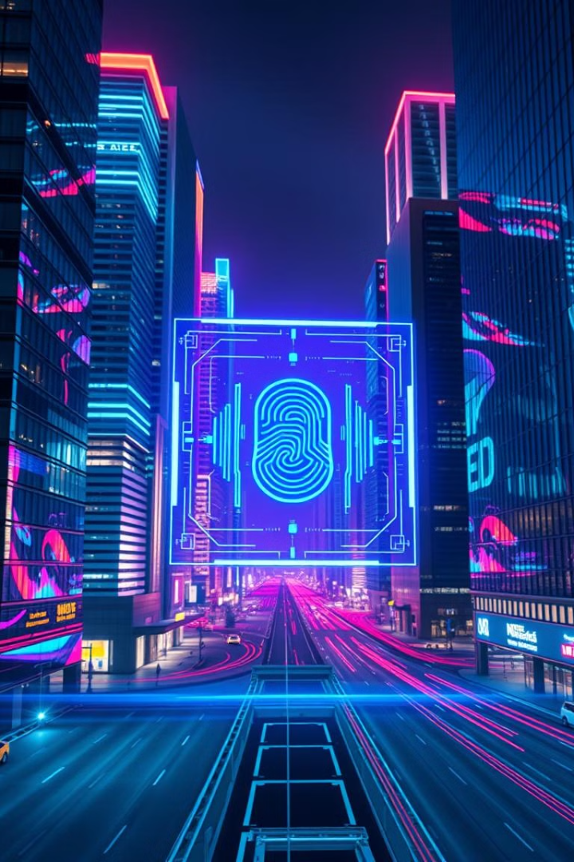
Biometric Verification for High-Risk Transactions
TEAM NAME :-
FRAUD SHIELD
Fraud Shield: Enhancing Security in Financial Transactions
SHRI RAMDEOBABA COLLEGE OF ENGINEERING (RBU)
TEAM MEMBERS :-
NAYAN GHATE
SHUBHAM SOLANKE
PRAJYOT KORDE
Github Link:-
https://github.com/Nayan-135/cyberhack25.git

Slide 2



The Problem: Account Rentals & Fraud
Bank Account Rental & Financial Fraud Issues
Why Traditional Methods Fail ?
Cybercriminals rent bank accounts for illegal activities.
Fake accounts are used for money laundering & fraud.
Static KYC checks fail to detect account rentals.
Need for biometric-based real-time identity verification.

Slide 3
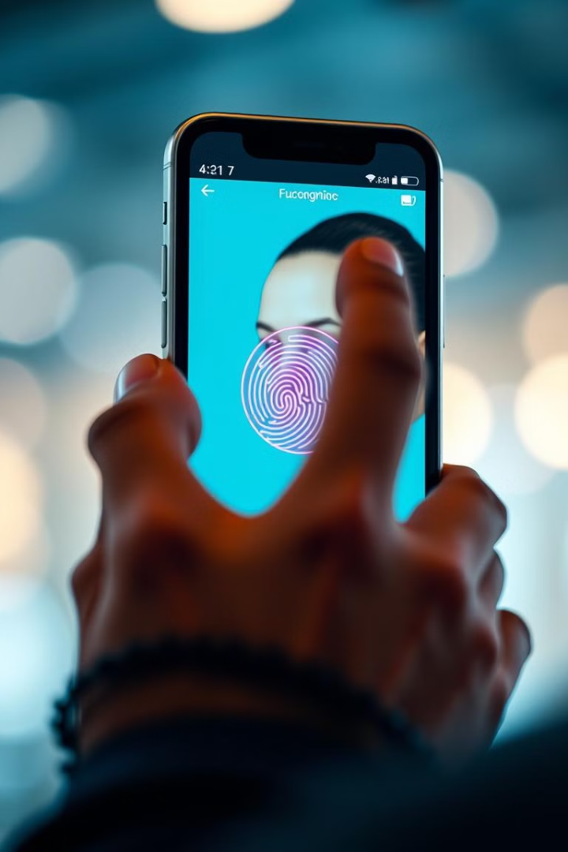
The Proposed Solution:
Multi-layer Verification System
Fingerprint Verification
Live Facial Scan
Real time instant fingerprint matching with bank’s biometric database.
Required for flagged accounts, ensures real owner.
AI-Powered Fraud Detection
via Transaction Behaviour-Based Risk Analysis , Monitoring transaction
patterns, device fingerprints, IP changes, and unusual spending behaviour.

Slide 4




Feasibility Analysis
Technically Feasible
Operationally Feasible
Biometric authentication (fingerprint & facial recognition) is widely used in mobile banking apps.
Real-time photo & fingerprint verification is possible with AI-based liveness detection & cloud biometric matching.
Multi-factor authentication (MFA), including OTP & video verification, is already in use by financial institutions.
AI-driven fraud detection using machine learning models can analyze user behavior & detect anomalies.
Smartphones already support biometric authentication, making it easy for users.
Banks have KYC (Know Your Customer) data, which can be enhanced with real-time verification.
Regulatory requirements (GDPR, PCI-DSS) already allow biometric security measures.

Slide 5
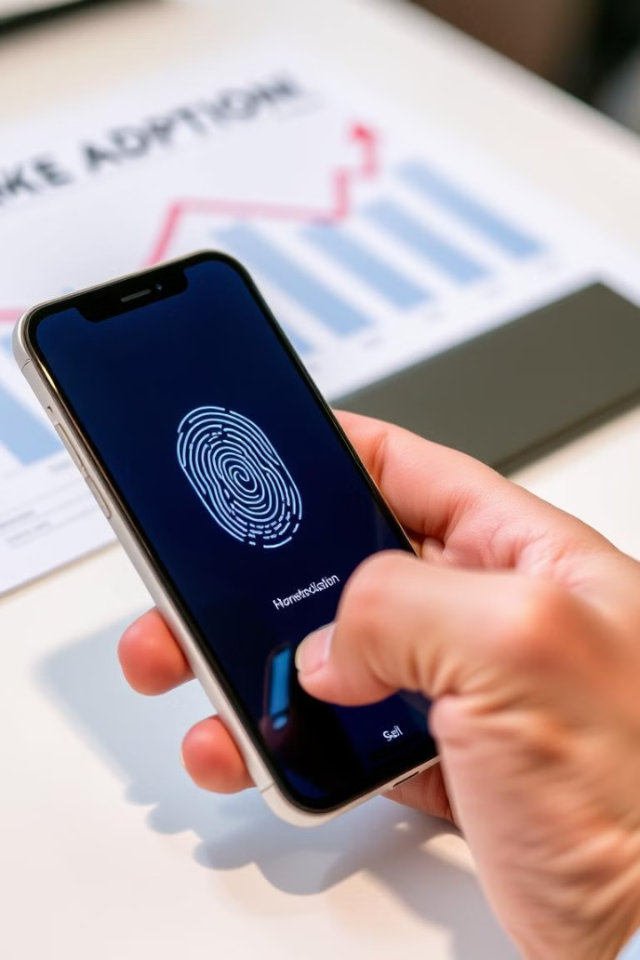







Viability & Market Adoption
User Acceptance & Privacy Concerns
Scalability
Users are comfortable with biometrics (Apple Face ID, Android Fingerprint Login).
Privacy concerns exist, but data encryption & regulatory compliance (GDPR, ISO 27001) can ensure security.
Cloud-based solutions (AWS, Azure) can easily scale biometric authentication to millions of users.
AI-driven fraud detection models continuously improve over time
Competitive Advantage for Banks
Prevents financial fraud & account rentals→ Reduces risks for banks.
Improves customer trust → More secure transactions lead to higher user retention.
Differentiation from competitors → Many banks still rely on passwords & OTPs, making this a game-changer.

Slide 6


Tech Stack for Implementation
1
2
3
Biometric Authentication & AI Models
✅ Face & Fingerprint Recognition : OpenCV, Android Biometric API
✅ Liveness Detection AI :AWS Recognition, Azure Face API
✅ Fraud Detection Models :TensorFlow, Scikit-Learn
Cloud & Backend Infrastructure
✅ Cloud Platforms : AWS, Google Cloud, Firebase
✅ Database for Secure Storage: PostgreSQL, Firebase.
✅ Backend Development:
Node.js, Flask
Transaction Monitoring & Fraud Detection
✅ Anomaly Detection : XGBoost, Random Forest
✅ Device & Location Tracking : Google SafetyNet, IP Geolocation API
✅ Real-Time Monitoring –:Apache Kafka, Firebase Realtime Database

Slide 7
What’s Missing?
(Opportunity!)
Existing Examples
🔹 UPI Payment Systems (India) – Plans to integrate Aadhaar-based biometric authentication for transactions. But currently there is no real-time verification before transactions.
🔹 Apple Face ID & Android Fingerprint Login – Used for logging into banking apps but not for real-time verification before transactions.
🔹 PayPal & Venmo MFA – Uses OTP & device recognition but not biometric verification before high-risk transactions.
🔹 Wells Fargo & HSBC – Use voice & facial recognition for authentication but not for transaction-level biometric checks.
❌ Most banks only use biometrics for login, NOT real-time verification before transactions.
❌ No system integrates real-time facial verification & fingerprint scans for flagged accounts.
✅ This presents an opportunity to develop an advanced fraud prevention system using AI & biometrics!

Slide 8




Datasets Required for AI Training
Biometric Data
Labeled Faces in the Wild (LFW), CASIA-FingerprintV5, MS-Celeb-1M.
Financial Fraud Data
IEEE-CIS Fraud Detection Dataset, Elliptic Bitcoin Dataset, PaySim.
Cybersecurity Data
UNSW-NB15 Dataset, CIC-IDS 2017 Dataset.

Slide 9







Why This Solution is the Future
1
Stops Account Rentals
2
Prevents Fraud
3
Ensures Compliance
4
Enhances Trust
5
Scalable & Cost-Effective

